Slide 1
RG-3000
Recommend a Game 3000
Notes:
Hello everyone, welcome to Recommend A Game 3000!
Do you ever feel overwhelmed by the number of video games out there? Our project aims to solve that problem. Using advanced data analysis, clustering, and personalized ranking, we'll help you discover your next favorite game with just a few simple inputs

Slide 2
Introduction
Pabel Nuñez Landestoy
In this presentation, we'll break down our process of building a video game recommendation system and demonstrate its practical application in a web app.
Notes:
My name is Pabel Nunez Landestoy
Today we will explore how we built a data-driven game recommendation system!

Slide 3
Overview
Data Gathering:
Type of game data collected, source and challenges.
Data Cleaning and Formatting:
Handling missing values, data type changes and features restructure for better analysis.
Data Analysis:
Relationships between features and correlation analysis.
Data Clustering:
Exploring Clustering of Game Data: Techniques and Insights.
Web Application:
Practical implementation using the final dataset.
Notes:
On this presentation we will talk about data gathering, cleaning, formatting, analysis, clustering and implementation

Slide 4

Data Gathering
Client
RAWG API
20
Notes:
**CLICK**
To create the dataset we harnessed the RAWG API using Python's 'requests' library.
**CLICK** Until orange arrow shows
One of the complications was with the API limitations with 20 record max per request and server errors.
For this situation we implemented a strategic list-based system to track the last successful API request. This enabled us to pick up exactly where we left off in case of errors.

Slide 5
Data Cleaning and Formatting
110,480
-94,722
15,758
15,758
INITIAL GAMES
REMOVED
GAMES
Notes:
To ensure accurate recommendations, we cleaned and formatted our raw dataset.
This process involved untangling nested data across multiple columns, resulting in a higher-quality dataset with over 15,000 games ready for analysis.

Slide 6
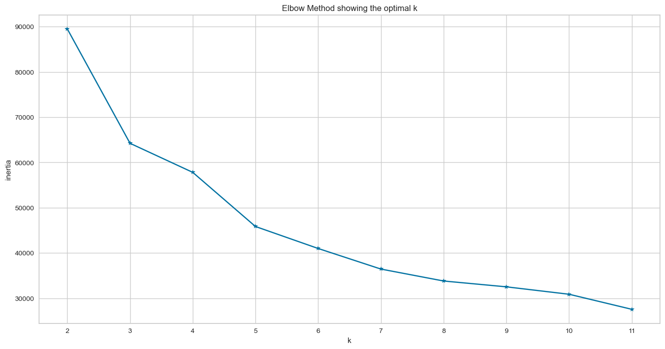
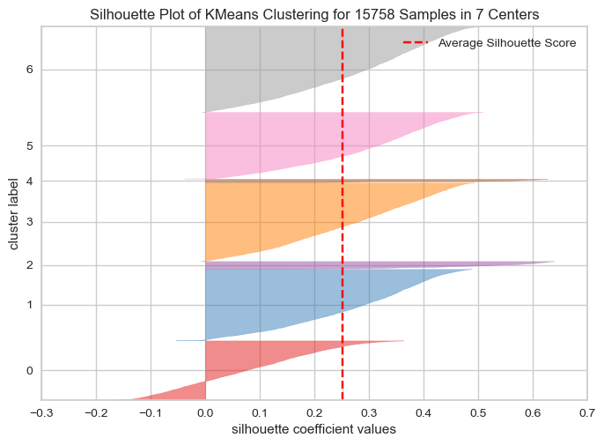
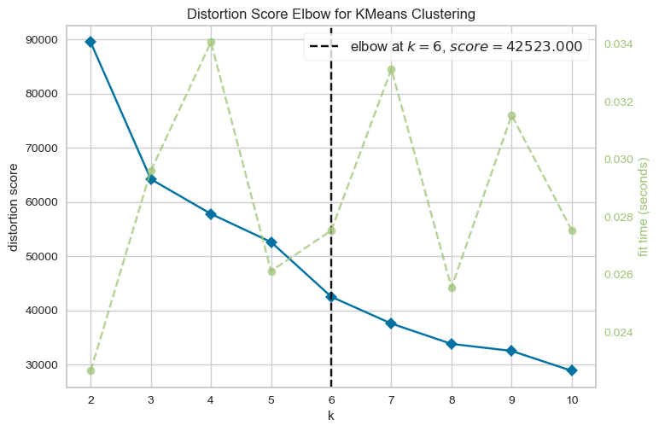
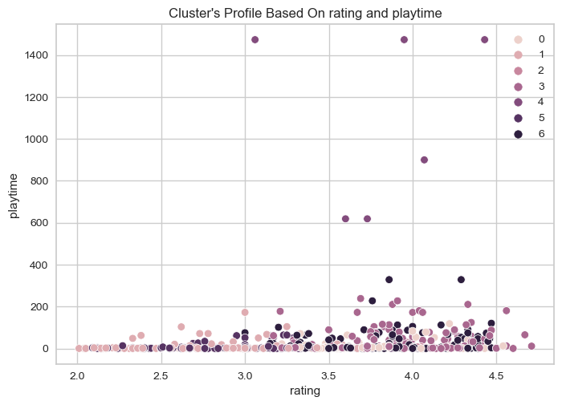
Data Clustering
KMEANS Algorithm
Low Inertia = Good
Silhouette Score: 0.25
Low distortion = Good
Notes:
For Data clustering we tested multiple clustering solutions like KMEANS, DBSCAN and AgglomerativeClustering.
*****CLICK*****
Lest start with KMEANS:
First we scaled the numeric data using StandardScaler and then we continued to visualize how the inertia behaves across multiple clusters scenarios. *****CLICK*****
After analysing the inertia and distortion values a good candidate is 7
*****CLICK*****
*****CLICK*****
To make the decision we took a look at the silhouette with 7 clusters , is good but not perfect, based on this findings we proceed to test other solutions

Slide 7
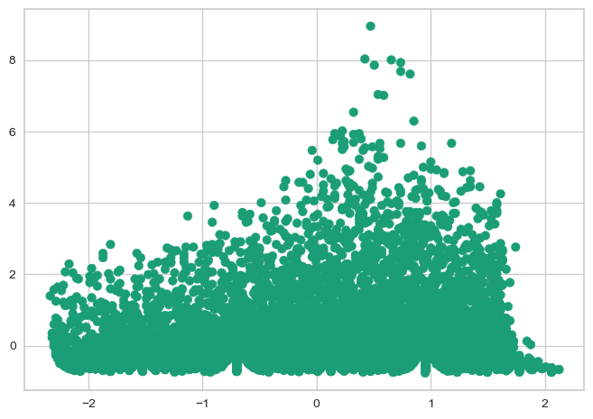
Data Clustering
DBSCAN Algorithm
Silhouette Score: -0.44
Notes:
After multiple verifications, Density-based spatial clustering scored lower than Kmeans with the best -0.44, as you can see on the image the data is very dense in some points.
Continuing to Agglomerative Clustering

Slide 8
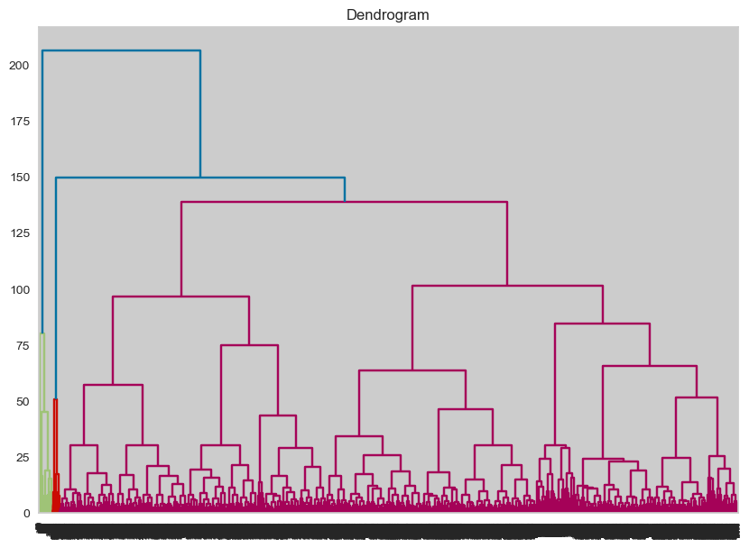
Data Clustering
AgglomerativeClustering Algorithm
Notes:
We tried the resource-heavy algorithm, the result didn’t meet our expectations.
***change slide***

Slide 9
The winner is:
KMeans with 7 Clusters
Notes:
After all the exploration, kmeans offers a better solution

Slide 10
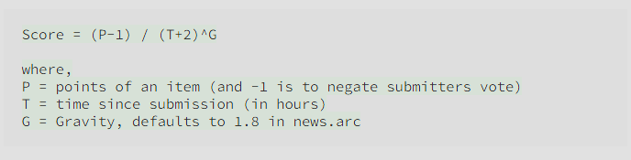
Game’s ranking
P = rating
T = released date
Notes:
We wanted to improve the system by adding ranking to the equation
-We used Hacker News ranking algorithm formula and replaced the variables according to the dataset.

Slide 11
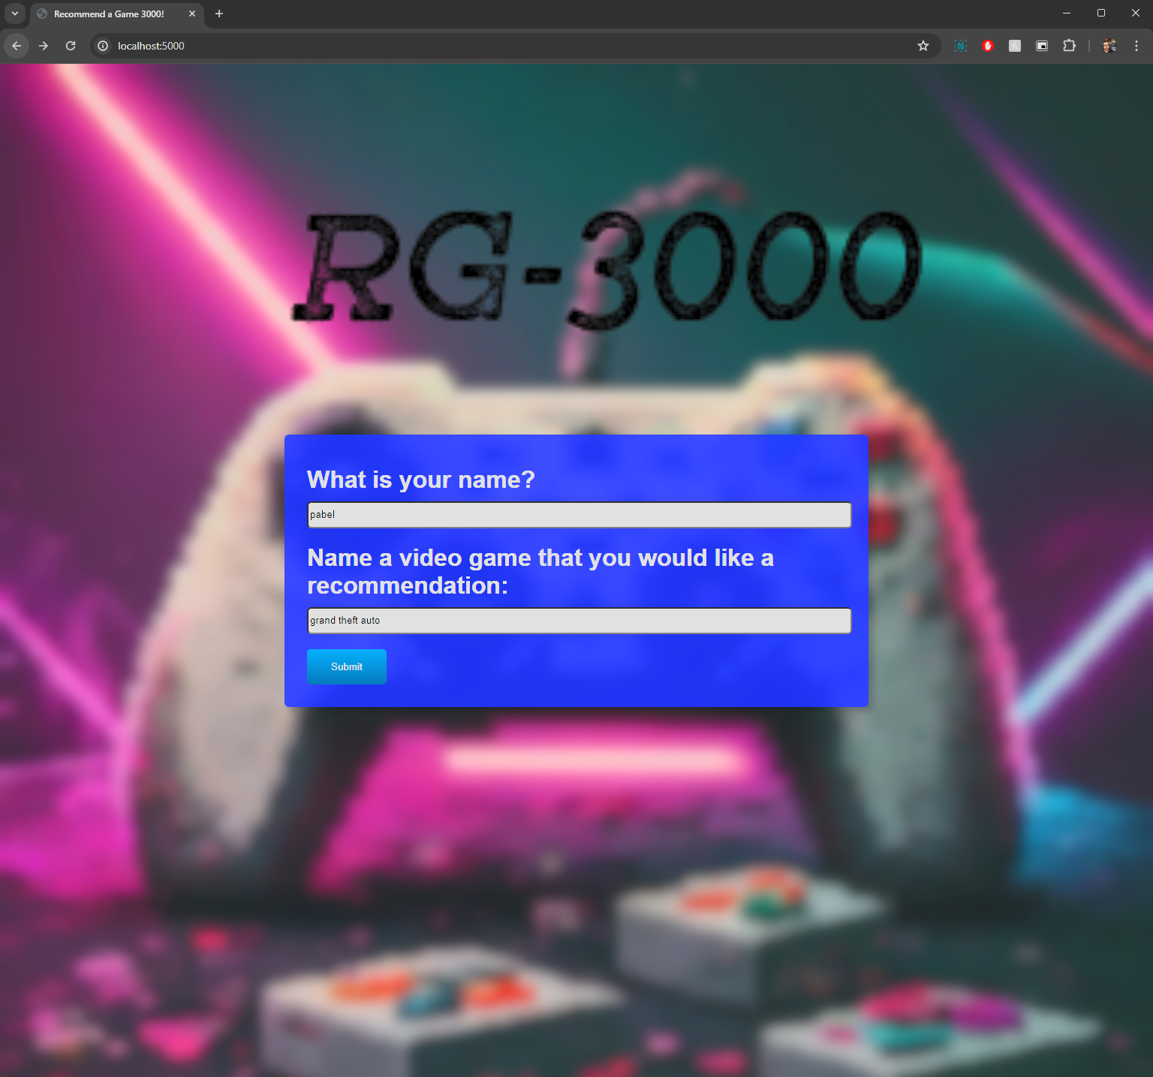
WEB APP
Simple but fierce
Notes:
Try our new game recommendation web app!
-Enter your name and a game you like for personalized suggestions

Slide 12
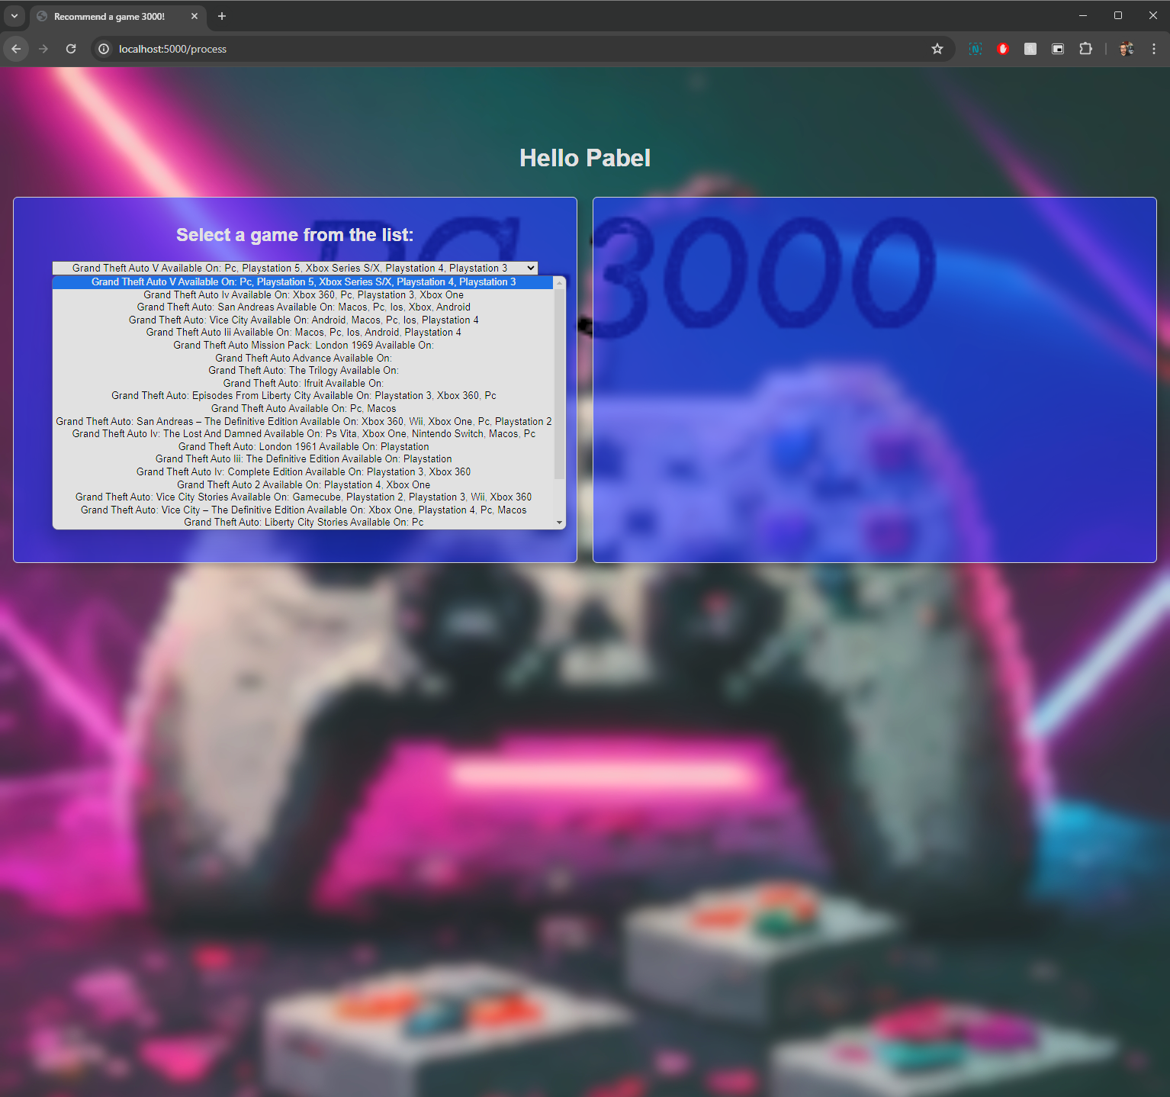
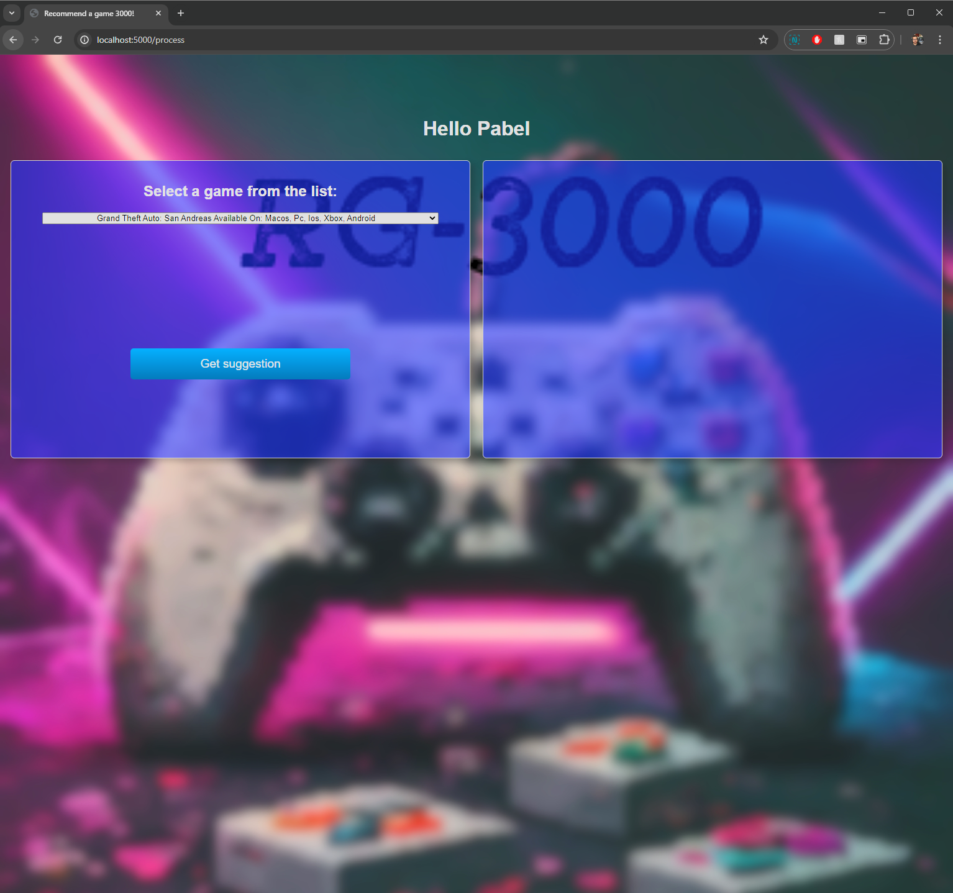
Click
Notes:
We search the already processed clustered dataset for games
The user can select one game from the list and click “Get suggestion”

Slide 13
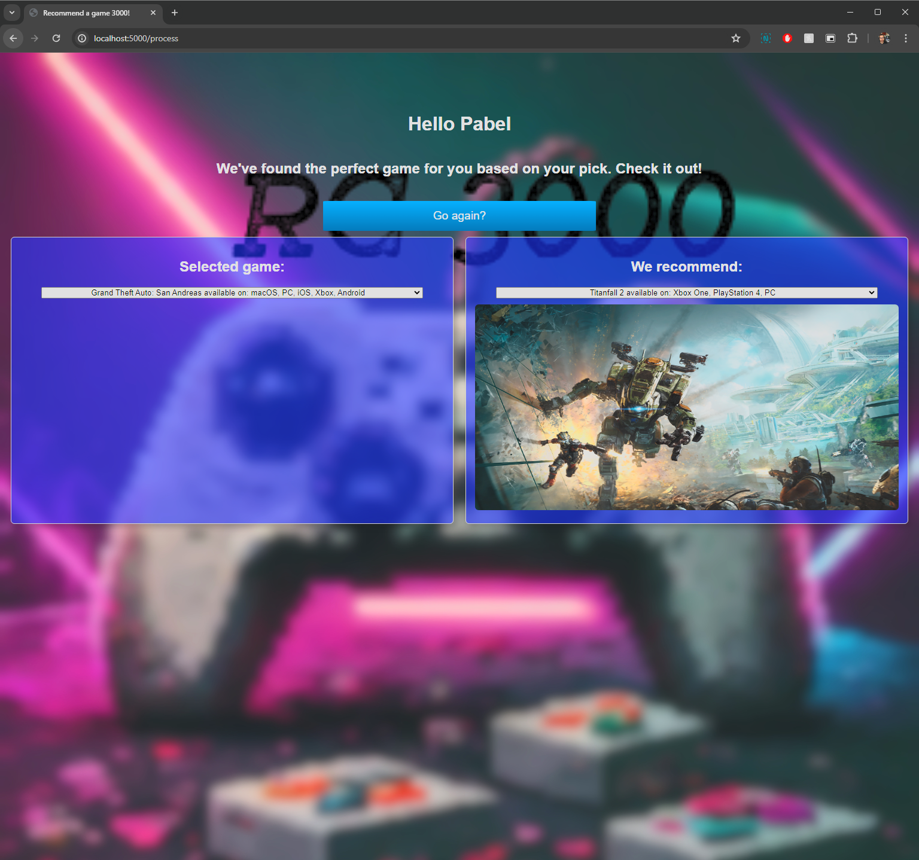
Notes:
The application finds games within the same cluster and selects the top ranking games from which one is selected randomly

Slide 14
wao!
What a ride!

Slide 15
Thank you

